Slide 1
Performance

Slide 2

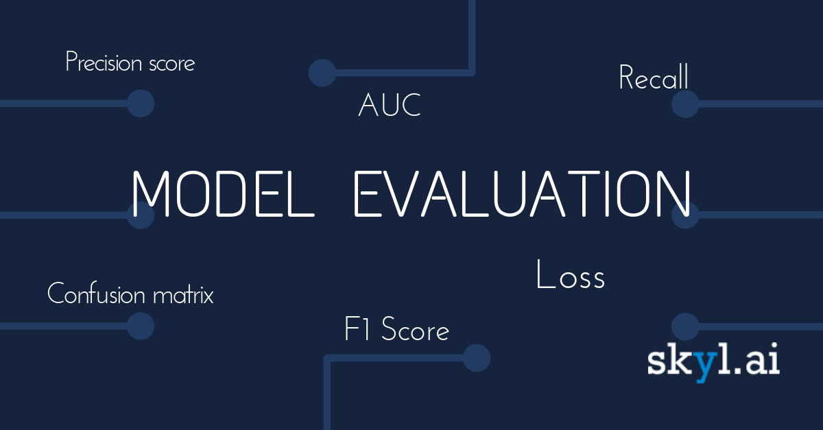
Classification—A Three-Step Process
Model construction / induction
Record labeling
Splitting the labelled data into a training set and a testing set
Inducing the model(s) from the training set
Model evaluation
Measuring the accuracy rate on the testing set
Comparing to the default (majority) rule
Model usage
Classifying new, unlabeled records

Slide 3
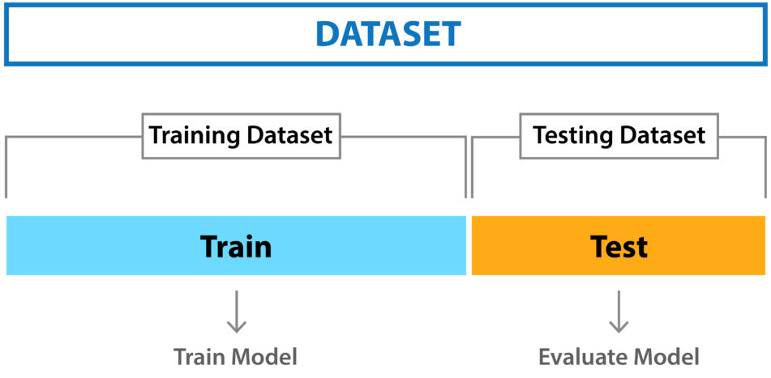
Train-Test Split
Goal:
The objective is to estimate the performance of the machine learning model on new data: data not used to train the model.

Slide 4
Train-Test Split
The train-test split is a technique for evaluating the performance of a machine learning algorithm.
It can be used for classification or regression problems and can be used for any supervised learning algorithm.

Slide 5
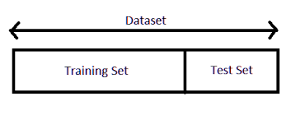
Train-Test Split
The procedure involves taking a dataset and dividing it into two subsets.
The first subset is used to fit the model and is referred to as the training dataset.
The second subset is not used to train the model; instead, the input element of the dataset is provided to the model, then predictions are made and compared to the expected values.
This second dataset is referred to as the test dataset.

Slide 6
Train-Test Split
Training set - Used to induce the classification model
Test set - Used to estimate the error rate of the induced model
common split percentages include:
Train: 80%, Test: 20%
Train: 67%, Test: 33%
Train: 50%, Test: 50%

Slide 7
When to Use the Train-Test Split
The idea is that there is enough data to split the dataset into train and test datasets and each of the train and test datasets are suitable representations of the problem domain.
This requires that the original dataset is also a suitable representation of the problem domain.
A suitable representation of the problem domain means that there are enough records to cover all common cases and most uncommon cases in the domain.
This might mean combinations of input variables observed in practice.
It might require thousands, hundreds of thousands, or millions of examples.

Slide 8
When to Use the Train-Test Split
Therefore, the train-test procedure is not appropriate when the dataset available is small.
The reason is that when the dataset is split into train and test sets, there will not be enough data in the training dataset for the model to learn an effective mapping of inputs to outputs.
There will also not be enough data in the test set to effectively evaluate the model performance.
The estimated performance could be overly optimistic (good) or overly pessimistic (bad).

Slide 9
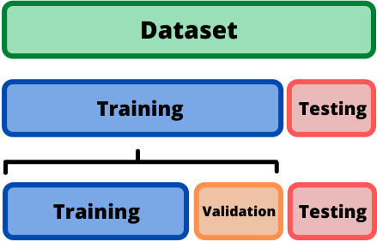
Train-Validation-Test Split
Training set - Used to induce the classification model
Validation set - Used to tune the model parameters
Test set - Used to evaluate the model performance

Slide 10
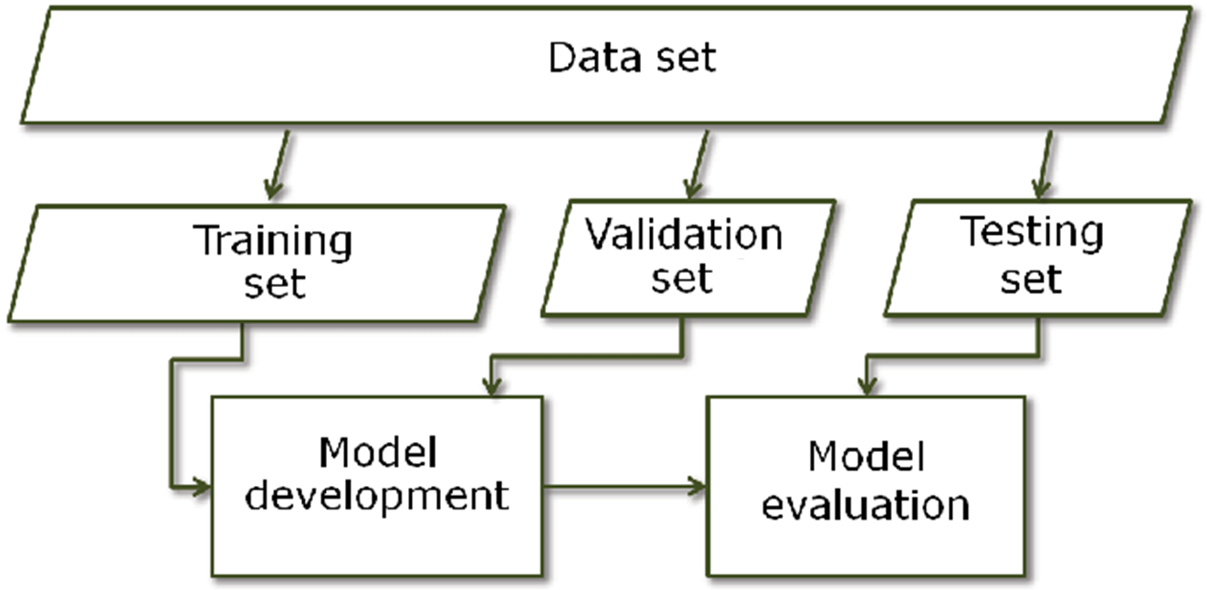
Train-Validation-Test Split

Slide 11
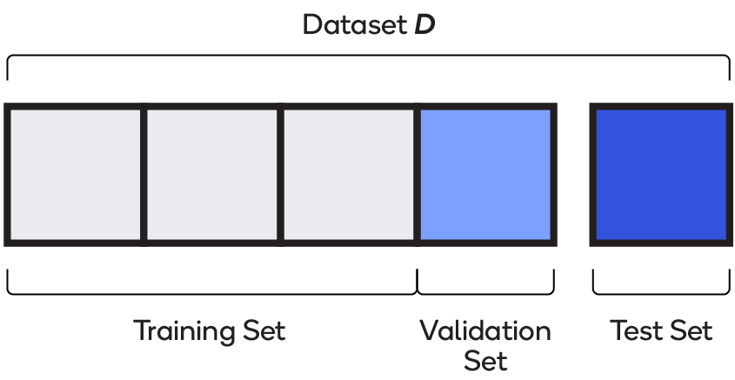
Train-Validation-Test Split

Slide 12

k-fold cross-validation
If you have insufficient data, then a suitable alternate model evaluation procedure would be the k-fold cross-validation procedure.

Slide 13
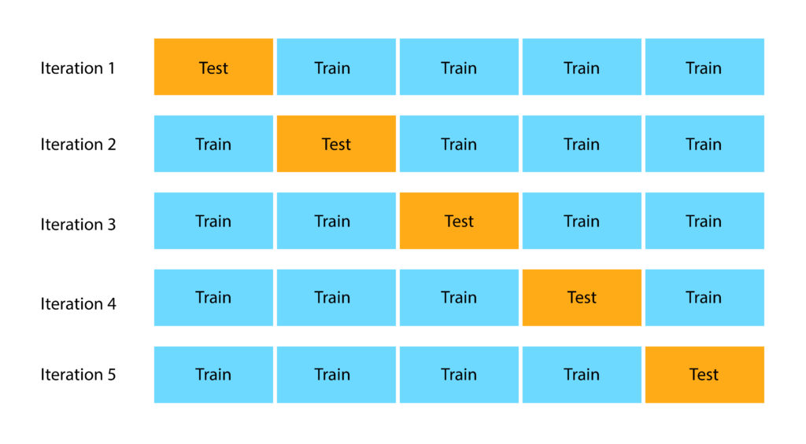
k-fold cross-validation

Slide 14
Model Evaluation and Selection
Now that you may have built a classification model, we would like to understand hog good is it?
For example, suppose you used data from previous sales to build a classifier to predict customer purchasing behavior.
You would like an estimate of how accurately the classifier can predict the purchasing behavior of future customers, that is, future customer data on which the classifier has not been trained.
You may even have tried different methods to build more than one classifier and now wish to compare their accuracy.
But what is accuracy? How can we estimate it? Are some measures of a classifier’s accuracy more appropriate than others?How can we obtain a reliable accuracy estimate? These questions are addressed in this section.

Slide 15
Model Evaluation and Selection
Now that you may have built a classification model, we would like to understand how good is it?
For example, suppose you used data from previous sales to build a classifier to predict customer purchasing behavior.
You would like an estimate of how accurately the classifier can predict the purchasing behavior of future customers, that is, future customer data on which the classifier has not been trained.
You may even have tried different methods to build more than one classifier and now wish to compare their accuracy.

Slide 16
Model Evaluation and Selection
But what is accuracy?
How can we estimate it?
Are some measures of a classifier’s accuracy more appropriate than others?
How can we obtain a reliable accuracy estimate?

Slide 17
Metrics for Evaluating Classifier Performance
accuracy (also known as recognition rate),
sensitivity (or recall),
specificity,
precision,
F1

Slide 18
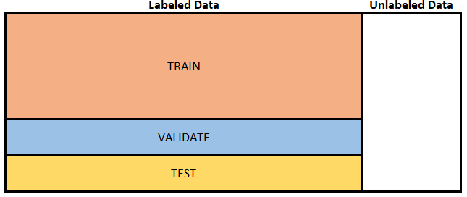
Metrics for Evaluating Classifier Performance
Using training data to derive a classifier and then estimate the accuracy of the resulting learned model can result in misleading overoptimistic estimates due to overspecialization of the learning algorithm to the data.
Instead, it is better to measure the classifier’s accuracy on a test set consisting of class-labeled tuples that were not used to train the model.

Slide 19
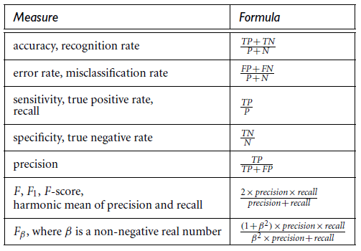
Performance Measures

Slide 20
Metrics for Evaluating Classifier Performance
positive tuples (tuples of the main class of interest)
negative tuples (all other tuples)
For example, Given two classes, the positive tuples may
positive tuples (buys_computer =yes)
negative tuples (buys_computer =no)
Suppose we use our classifier on a test set of labeled tuples.
P is the number of positive tuples and N is the number of negative tuples.
For each tuple, we compare the classifier’s class label prediction with the tuple’s known class label.

Slide 21
Metrics for Evaluating Classifier Performance
True positives (TP): These refer to the positive tuples that were correctly labeled by
the classifier. Let TP be the number of true positives.
True negatives (TN): These are the negative tuples that were correctly labeled by the classifier. Let TN be the number of true negatives.
False positives (FP): These are the negative tuples that were incorrectly labeled as
positive (e.g., tuples of class buys computer =no for which the classifier predicted
buys computer=yes). Let FP be the number of false positives.
False negatives (FN): These are the positive tuples that were mislabeled as negative
(e.g., tuples of class buys computer = yes for which the classifier predicted
buys computer =no). Let FN be the number of false negatives

Slide 22
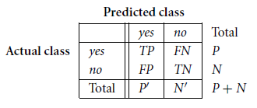
Metrics for Evaluating Classifier Performance
These terms are summarized in a confusion matrix.
The confusion matrix is a useful tool for analyzing how well your classifier can recognize tuples of different classes.
TP and TN tell us when the classifier is getting things right, while FP and FN tell us when the classifier is getting things wrong (i.e., mislabeling).

Slide 23

Accuracy
The accuracy of a classifier on a given test set is the percentage of test set tuples that are correctly classified by the classifier.
It also known as recognition rate of the classifier, that is, it reflects how well the classifier recognizes tuples of the various classes.

Slide 24
Accuracy (Example)
Buys_computer=no | Buys_computer=yes | Classes
46 | 6,954 | Buys_computer=yes
2,588 | 412 | Buys_computer=no

Slide 25
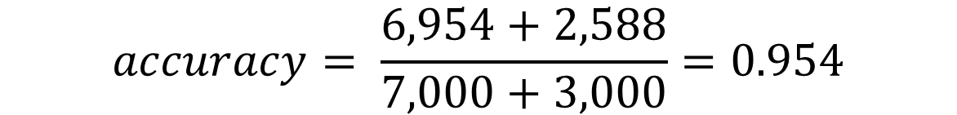
Accuracy (Example)
Total | Buys_computer=no | Buys_computer=yes | Classes
7,000 | 46 | 6,954 | Buys_computer=yes
3,000 | 2,588 | 412 | Buys_computer=no
10,000 |  |  | Total
$$accuracy= \frac{6,954+2,588}{7,000+3,000}=0.954$$
Notes:
תחילה נחשב את ה-Totals

Slide 26


Error Rate
Error rate or misclassification rate of a classifier, M, which is simply
$1−accuracy(M)$, where $accuracy(M)$ is the accuracy of M.

Slide 27
Resubstitution Rate
If we were to use the training set (instead of a test set) to estimate the error rate of a model, this quantity is known as the resubstitution error.
This error estimate is optimistic of the true error rate (and similarly, the corresponding accuracy estimate is optimistic) because the model is not tested on any samples that it has not already seen.

Slide 28
Accuracy measure
Q: You measured the accuracy of a classifier distinguishing between girls and boys’ images. You received an accuracy of 0.8. Is it good?
In order to answer this question, we need an additional information regarding the distribution of the records and their predictions.
Assume that the test set consists of 1,000 records.
800
200
Girls
Boys

Slide 29

Accuracy measure
In this case, we conclude that the classifier is not useful, predicting each record as a girl.

Slide 30
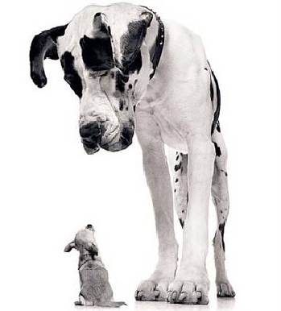
Class imbalanced problem
In this case, we conclude that the classifier is not useful, predicting each record as a girl.
We faced here to the class imbalance problem, where the main class of interest is rare.
That is, the data set distribution reflects a significant majority of the negative class and a minority positive class. For example, in fraud detection applications, the class of interest (or positive class) is “fraud,” which occurs much less frequently than the negative “nonfraudulant” class.

Slide 31
Class imbalanced problem
In medical data, there may be a rare class, such as “cancer.”
Suppose that you have trained a classifier to classify medical data tuples, where the class label attribute is “cancer” and the possible class values are “yes” and “no.”
An accuracy rate of, say, 97% may make the classifier seem quite accurate, but what if only, say, 3% of the training tuples are actually cancer? Clearly, an accuracy rate of 97% may not be acceptable—the classifier could be correctly labeling only the non-cancer tuples, for instance, and misclassifying all the cancer tuples.
Instead, we need other measures, which access how well the classifier can recognize the positive tuples (cancer = yes) and how well it can recognize the negative tuples (cancer = no)

Slide 32
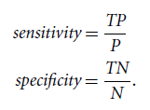
Sensitivity and Specificity
The sensitivity and specificity measures can be used, respectively, for this purpose.
Sensitivity is also referred to as the true positive (recognition) rate (i.e., the proportion of positive tuples that are correctly identified), while specificity is the true negative rate (i.e., the proportion of negative tuples that are correctly identified).

Slide 33

Class imbalanced problem
It can be shown that accuracy is a function of sensitivity and specificity:

Slide 34
Sensitivity and Specificity
Q: The following table shows a confusion matrix for medical data, where the class values are yes and no for a class label attribute, Covid-19.
What is the accuracy, sensitivity, and specificity?
no | yes | Classes
210 | 90 | yes
9,560 | 140 | no

Slide 35
Sensitivity and Specificity
Total | Predicted(no) | Predicted(yes) | Classes
300 | 210 | 90 | yes
9,700 | 9,560 | 140 | no
10,000 | 9,770 | 230 | Total
$$accuracy= \frac{90+9,560}{300+9,700}=\frac{9,650}{10,000}=0.965$$
$$sensitivity= \frac{90}{300}=0.3$$
$$specificity= \frac{9,560}{9,700}=0.985$$
Notes:
Thus, we note that although the classifier has a high accuracy, it’s ability to correctly label the positive (rare) class is poor given its low sensitivity.
It has high specificity, meaning that it can accurately recognize negative tuples.
Techniques for handling class-imbalanced data are given in Section 8.6.5.

Slide 36


Precision and Recall
The precision and recall measures are also widely used in classification.
Precision can be thought of as a measure of exactness (i.e., what percentage of tuples labeled as positive are actually such)
Recall is a measure of completeness (what percentage of positive tuples are labeled as such).
Notes:
If recall seems familiar, that’s because it is the same as sensitivity (or the true positive rate). These measures can be computed as

Slide 37
Precision and Recall (Example)
Q: The following table shows a confusion matrix for medical data, where the class values are yes and no for a class label attribute, Covid-19.
What is the precision and recall?
no | yes | Classes
210 | 90 | yes
9,560 | 140 | no

Slide 38


Sensitivity and Specificity
Total | Predicted(no) | Predicted(yes) | Classes
300 | 210 | 90 | yes
9,700 | 9,560 | 140 | no
10,000 | 9,770 | 230 | Total
$$precision= \frac{90}{230}=0.3913$$
$$recall= \frac{90}{300}=0.3$$
Notes:
Thus, we note that although the classifier has a high accuracy, it’s ability to correctly label the positive (rare) class is poor given its low sensitivity.
It has high specificity, meaning that it can accurately recognize negative tuples.
Techniques for handling class-imbalanced data are given in Section 8.6.5.

Slide 39
Precision and Recall
A perfect precision score of 1.0 for a class C means that every tuple that the classifier labeled as belonging to class C does indeed belong to class C.
However, it does not tell us anything about the number of class C tuples that the classifier mislabeled.
A perfect recall score of 1.0 for C means that every item from class C was labeled as such, but it does not tell us how many other tuples were incorrectly labeled as belonging to class C.
There tends to be an inverse relationship between precision and recall, where it is possible to increase one at the cost of reducing the other.
For example, our medical classifier may achieve high precision by labeling all COVID-19 tuples that present a certain way as COVID-19, but may have low recall if it mislabels many other instances of COVID-19 tuples.
Precision and recall scores are typically used together, where precision values are compared for a fixed value of recall, or vice versa. For example, we may compare precision values at a recall value of, say, 0.75.
Notes:
If recall seems familiar, that’s because it is the same as sensitivity (or the true positive rate). These measures can be computed as

Slide 40
Precision and Recall in Information Retrieval
Entire document collection
retrieved & irrelevant
Not retrieved & irrelevant
irrelevant
Relevant documents
Retrieved documents
Relevant documents
retrieved & relevant
not retrieved but relevant
relevant
retrieved
not retrieved
Notes:
Taken from Prof. Bracha Shapira

Slide 41
Precision and Recall in Information Retrieval
Precision
The ability to retrieve top-ranked documents that are mostly relevant.
Recall
The ability of the search to find all of the relevant items in the corpus.
Notes:
If recall seems familiar, that’s because it is the same as sensitivity (or the true positive rate). These measures can be computed as

Slide 42

Precision and Recall in Information Retrieval
Example 1:
Repository size = 10,000 documents
Relevant = 200
Returned = 10,000
Relevant among Returned: 200
$$precision= ?$$
$$recall= ?$$
Notes:
If recall seems familiar, that’s because it is the same as sensitivity (or the true positive rate). These measures can be computed as

Slide 43
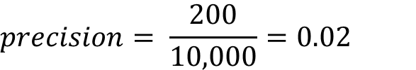

Precision and Recall in Information Retrieval
Example 1:
Repository size = 10,000 documents
Relevant = 200
Returned = 10,000
Relevant among Returned: 200
$$precision= \frac{200}{10,000}=0.02$$
$$recall= \frac{200}{200}=1$$
Notes:
If recall seems familiar, that’s because it is the same as sensitivity (or the true positive rate). These measures can be computed as

Slide 44
Precision and Recall in Information Retrieval
Example 2:
Repository size = 10,000 documents
Relevant = 200
Returned = 100
Relevant among Returned: 50
$$precision= ?$$
$$recall= ?$$
Notes:
If recall seems familiar, that’s because it is the same as sensitivity (or the true positive rate). These measures can be computed as

Slide 45


Precision and Recall in Information Retrieval
Example 2:
Repository size = 10,000 documents
Relevant = 200
Returned = 100
Relevant among Returned: 50
$$precision= \frac{50}{100}=0.5$$
$$recall= \frac{50}{200}=0.25$$
Notes:
If recall seems familiar, that’s because it is the same as sensitivity (or the true positive rate). These measures can be computed as

Slide 46
Trade-off between Recall and Precision
Returns relevant documents but
misses many useful ones too
The ideal
1
Precision
0
1
Recall
Returns most relevant
documents but includes
lots of junk
Notes:
If recall seems familiar, that’s because it is the same as sensitivity (or the true positive rate). These measures can be computed as

Slide 47
Precision@k
Graphs are good, but people want summary measures!
Precision at fixed retrieval level
Perhaps most appropriate for web search: all people want are good matches on the first one or two results pages
But has an arbitrary parameter of k
Example : Precision@5 measures precision of the 5 first documents retrieved by the engine
Notes:
If recall seems familiar, that’s because it is the same as sensitivity (or the true positive rate). These measures can be computed as

Slide 48
Mean Average Precision (MAP)
Mean average precision (MAP) – very popular measure – computed for a set of queries
Average of the precision value obtained for the top k documents, each time a relevant doc is retrieved
Average is computed over the actual recall points
Avoids interpolation, use fixed recall levels
MAP for query collection is arithmetic average over all queries
Macro-averaging: each query counts equally
Notes:
If recall seems familiar, that’s because it is the same as sensitivity (or the true positive rate). These measures can be computed as

Slide 49
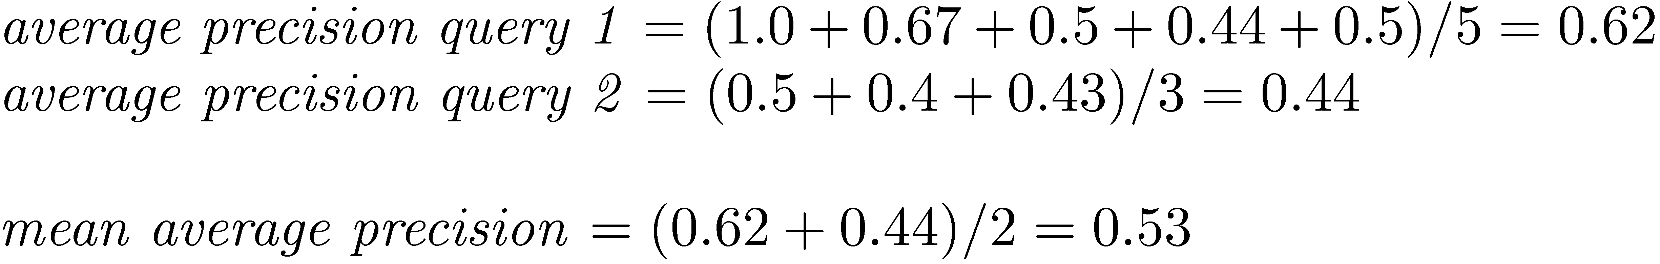
MAP
Notes:
If recall seems familiar, that’s because it is the same as sensitivity (or the true positive rate). These measures can be computed as

Slide 50
MAP
Notes:
If recall seems familiar, that’s because it is the same as sensitivity (or the true positive rate). These measures can be computed as

Slide 51
R-Precision
Precision at the R-th position in the ranking of results for a query that has R relevant documents.
R = # of relevant docs = 6
R-Precision = 4/6 = 0.67
Notes:
If recall seems familiar, that’s because it is the same as sensitivity (or the true positive rate). These measures can be computed as

Slide 52
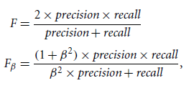

F-Score
An alternative way to use precision and recall is to combine them into a single measure.
This is the approach of the F measure (also known as the $F_{1}$ score or F-score) and the $F_{β}$ measure, where $β$ is a non-negative real number.
Notes:
If recall seems familiar, that’s because it is the same as sensitivity (or the true positive rate). These measures can be computed as

Slide 53
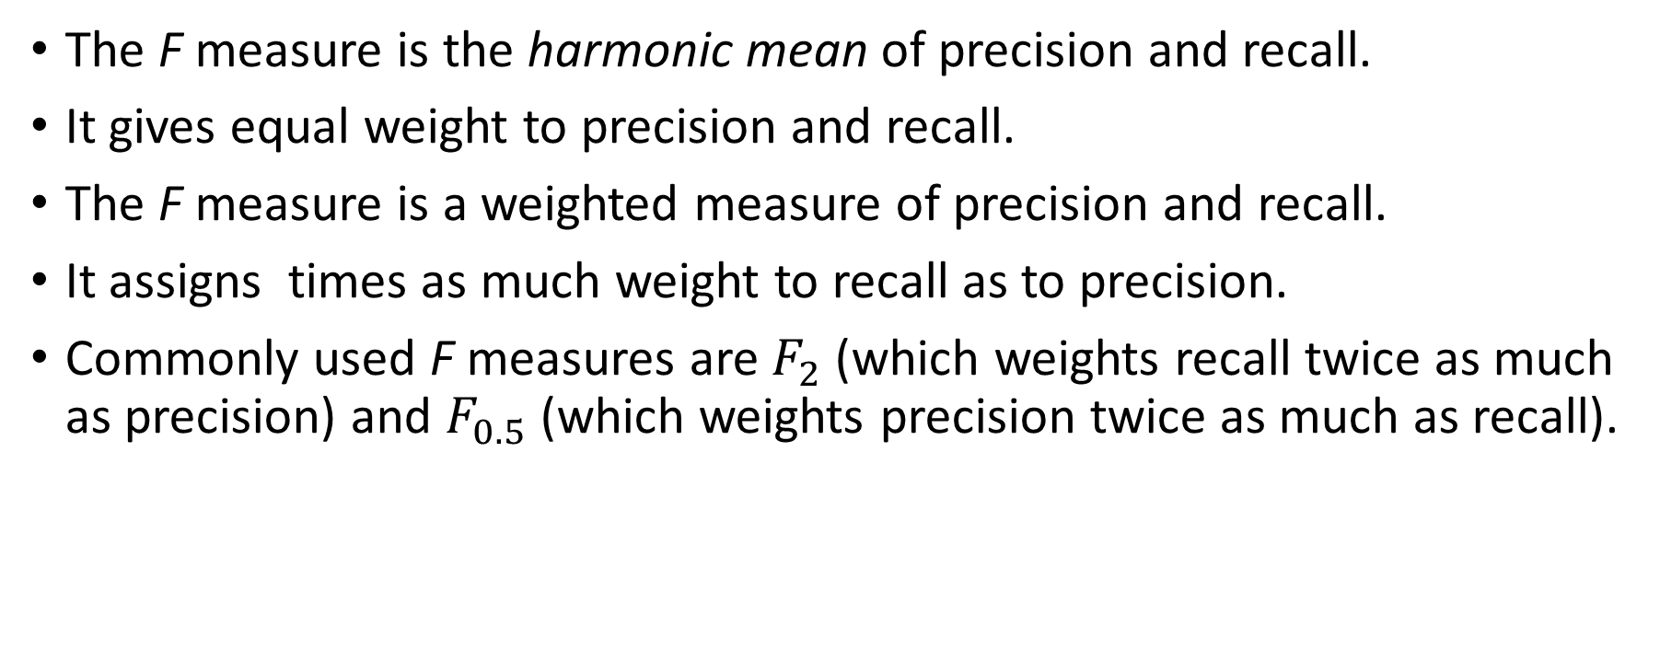
F-Score
The F measure is the harmonic mean of precision and recall.
It gives equal weight to precision and recall.
The F measure is a weighted measure of precision and recall.
It assigns times as much weight to recall as to precision.
Commonly used F measures are $F_{2}$ (which weights recall twice as much as precision) and $F_{0.5}$ (which weights precision twice as much as recall).
Notes:
If recall seems familiar, that’s because it is the same as sensitivity (or the true positive rate). These measures can be computed as

